Slide 1
Understanding LLMs abilities to deobfuscate Android Apps
Is it the end of ad-hoc deobfuscators?
Swiss Joint Master of Science in Computer Science
Student: Jacopo Caratti – Supervisor: Prof. Valerio Schiavoni

Slide 2




72%
Android dominates the smartphone market.
2

Slide 3
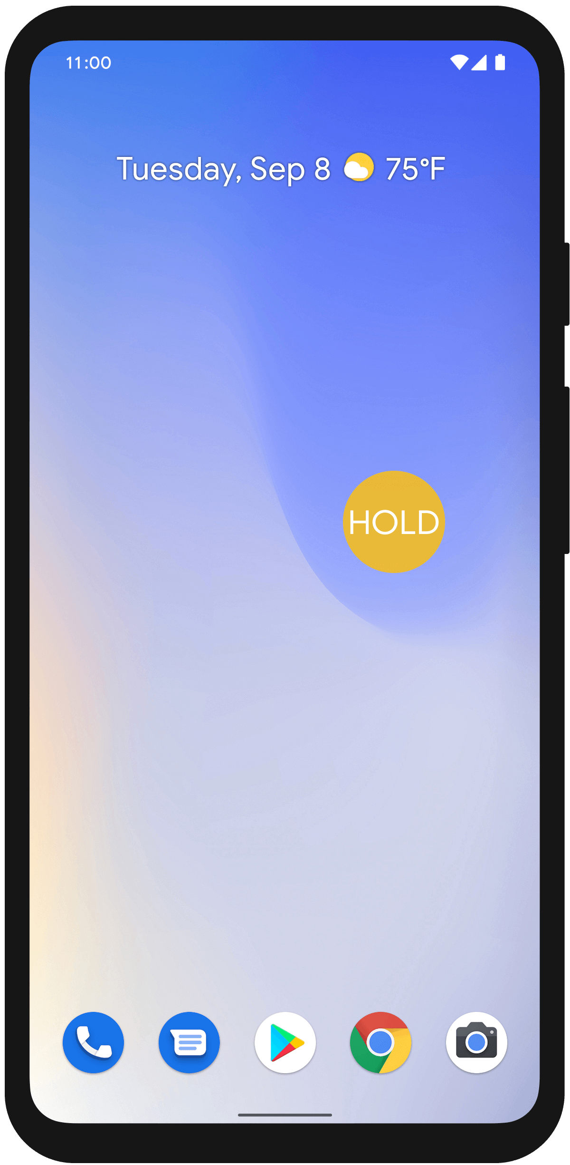






The Openness of the Android Ecosystem
F-Droid: 4,000
Amazon Appstore: 0.5 Mio
Google Play: 3.5 Mio
APK Pure: unknown
APK Mirror: unknown
Diverse marketplaces have a big impact on security
APK = Android Package Kit
3

Slide 4


Android malwares
1 malicious app every 10 seconds
4

Slide 5


Forensic analysis
Distinguish goodware from malware
Hybrid
Static
Dynamic
E.g. Drebin, Androguard
E.g. Madam, Blade
5
Notes:
detect malwares prior to their installation
protect user privacy and security

Slide 6
Obfuscation…what?
“The act of creating source or machine code that is difficult for humans or computers to understand.”
Wikipedia – Obfuscation (Software)
6

Slide 7


Double-edged sword
Malware
Goodware
Introduce additional complexity layers, protecting from reverse engineering
Safeguard intellectual property, deterring from copying the code
7

Slide 8
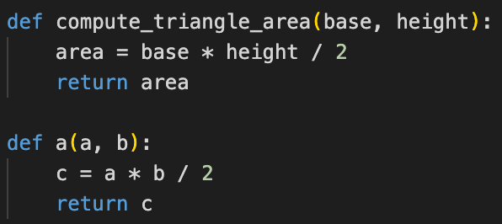

Identifier renaming
prevalent, simple and effective
obfuscation
Substitute meaningful identifier names with alternative ones: shorter, more obscure, or customized.
8

Slide 9

Identifier renaming
Variable, field, method, class level.
our target
9

Slide 10
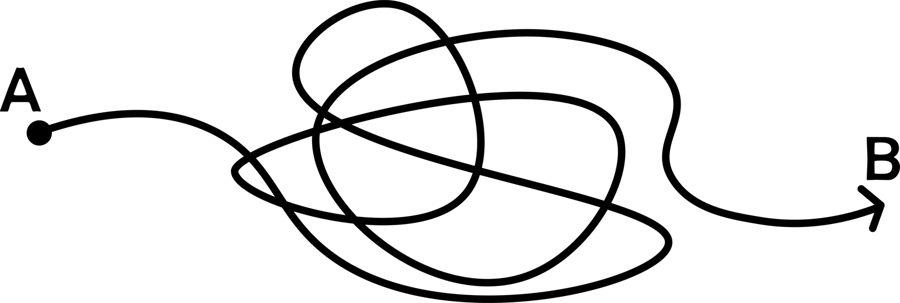


Obfuscation
field renaming
APK
obfuscated APK
ObfuscAPK
10

Slide 11

De-obfuscation
field renaming
APK
obfuscated APK
11

Slide 12



Existing de-obfuscation tools
old and code poorly maintained
Anti-ProGuard
Astana
ClassNameDeobfuscator
DeGuard
Dex-Oracle
JEB
Katalina
Simplify
TIRO
Deoptufuscator
DeProDexcator
closed source, target ProGuard, over 20 APKs obfuscated by us no one was correctly de-obfuscated
paid and closed source
Only few say to target field renaming but
don’t work or cannot be used
12

Slide 13


LLM
Ad Hoc Tool
Two parallel
ways to solve the task
13

Slide 14


DeofuscaThor
obfuscated APK
clear APK
Deep Learning
Processing
14

Slide 15
Supervised Learning
Input
Output
obfuscated APK
clear APK
15

Slide 16
Corpus
clear APKs
Crawl, check compatibility, disable obfuscation, compile APKs from F-Droid
16

Slide 17
Corpus
obfuscated APKs
clear APKs
obfuscate with ObfuscAPK
17

Slide 18
Corpus
obfuscated APK
clear APK
#449 pairs
= 678’946 Java methods
18

Slide 19
Existing projects
recover identifier names in decompiled code
2019
2022
DIRE
DIRTY
acc = 35.3%*
acc = 36.9%
Baseline implementation
2021
2024
DIRECT
VarBERT
acc = 42.8%*
acc = 50.7%
*poorly maintained code
biased evaluations
19

Slide 20
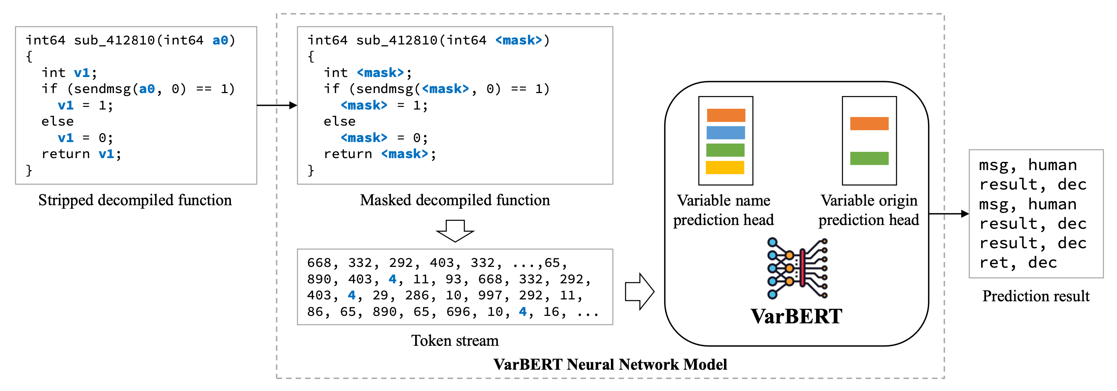
VarBERT
uses BERT to predict meaningful variable names in decompiled output
Paper: “Len or index or count, anything but v1”: Predicting Variable Names in Decompilation Output with Transfer Learning
20

Slide 21

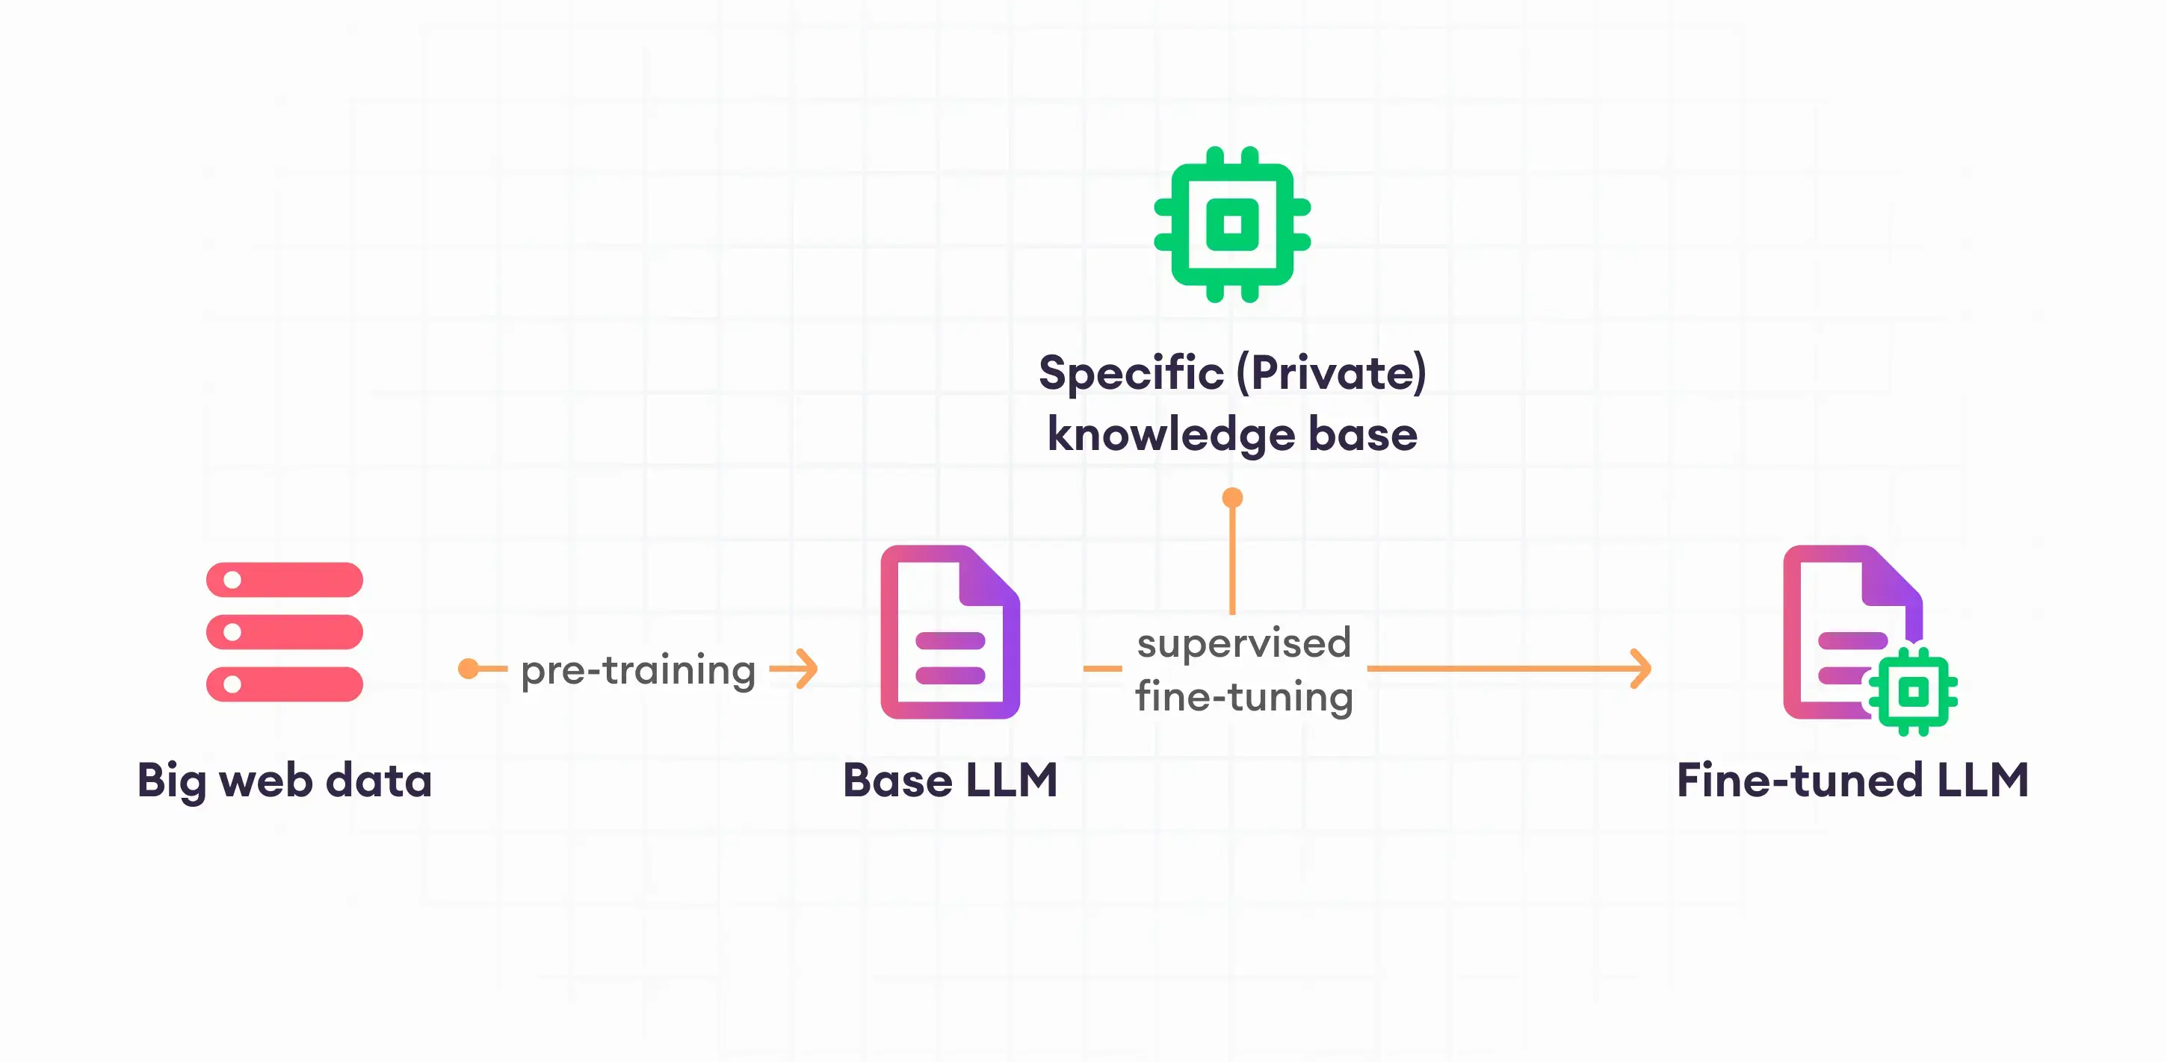
Transfer learning
Specific private medical data
21

Slide 22
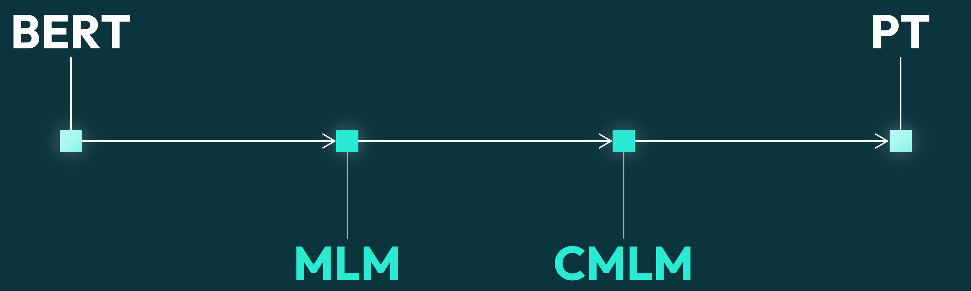
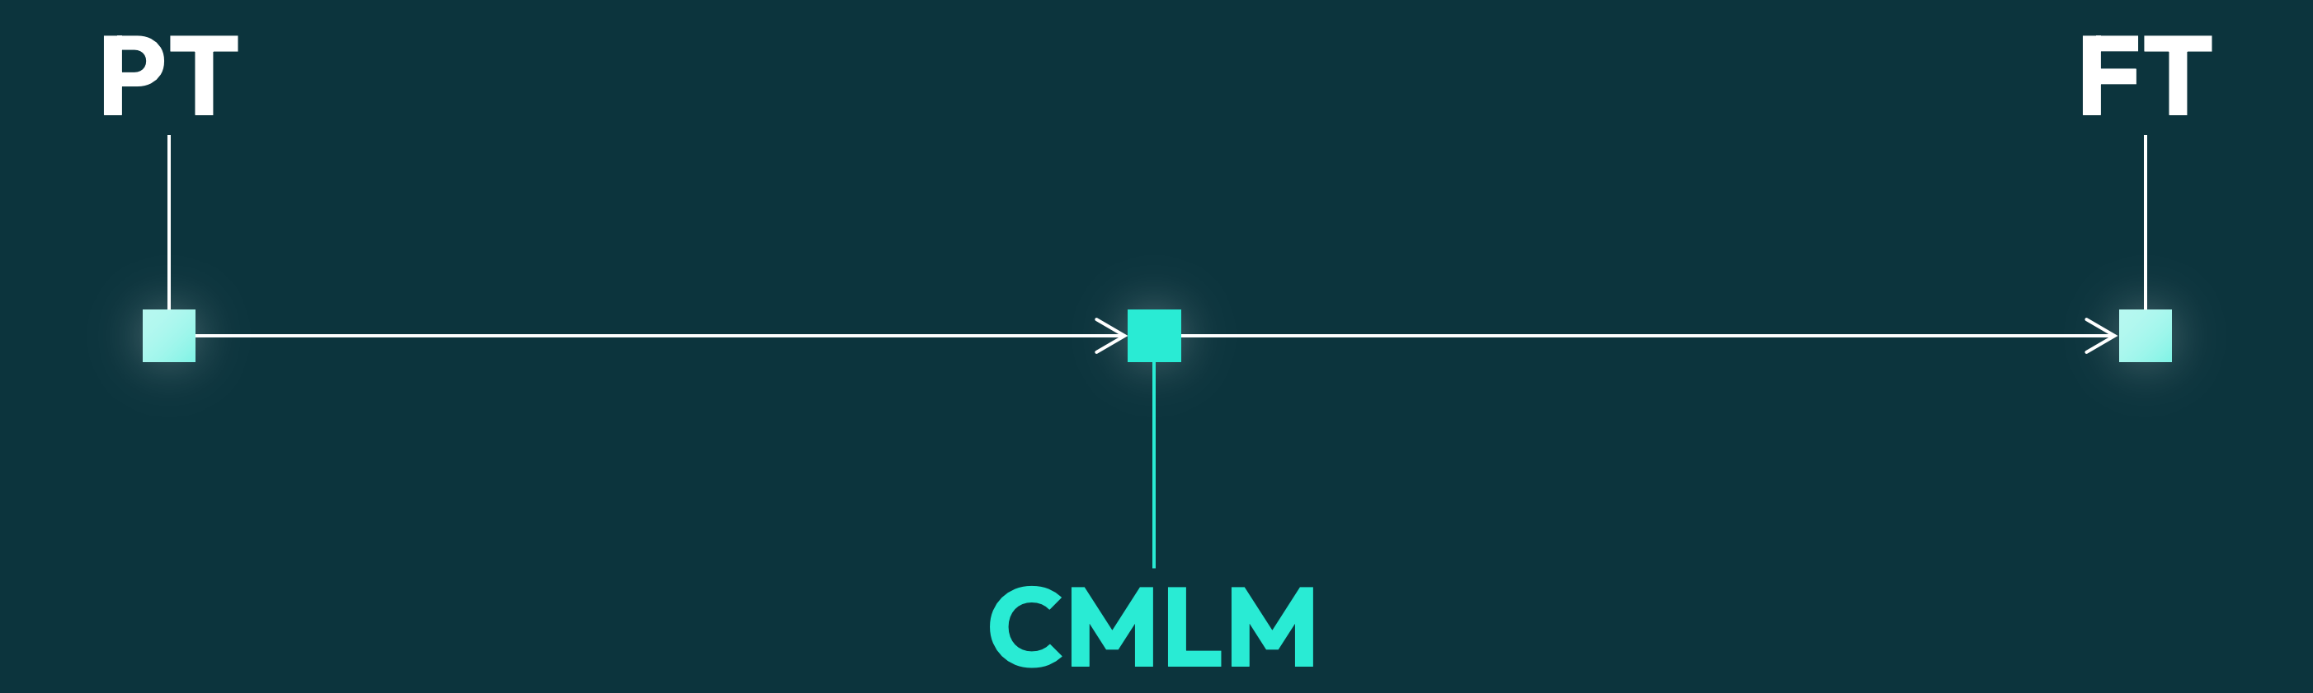

pre-training
fine-tuning
General code language knowledge
General code language knowledge
+
Code identifier names knowledge
22

Slide 23

pre-training
fine-tuning
General code language knowledge
Android APKs Java code
23

Slide 24


5,300,019
for pre-training
java methods
codeparrot/github-code-clean
24

Slide 25

pre-training
fine-tuning
General Java code
Android APKs Java code
25

Slide 26
DeofuscaThor
obfuscated APK
clear APK
Deep Learning
Processing
26
Notes:
13

Slide 27
LLM
Ad Hoc Tool
Two parallel
ways to solve the task
27

Slide 28

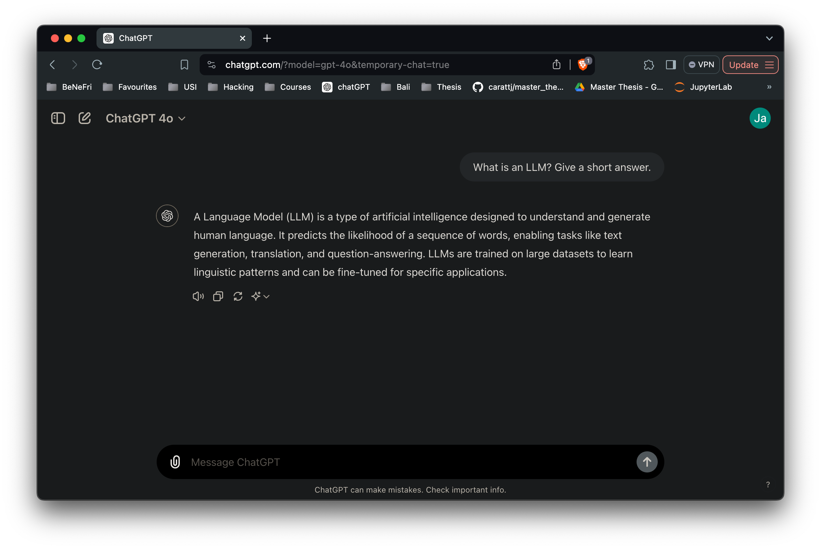
Large Language Model
28

Slide 29

Code-Specific LLMs
55%
75%
46%
Big impact in software development/analysis due to their capabilities.
GitHub Copilot
Faster coding
More fulfilled
Code written
Paper: Quantifying GitHub Copilot’s impact on developer productivity and happiness
29

Slide 30
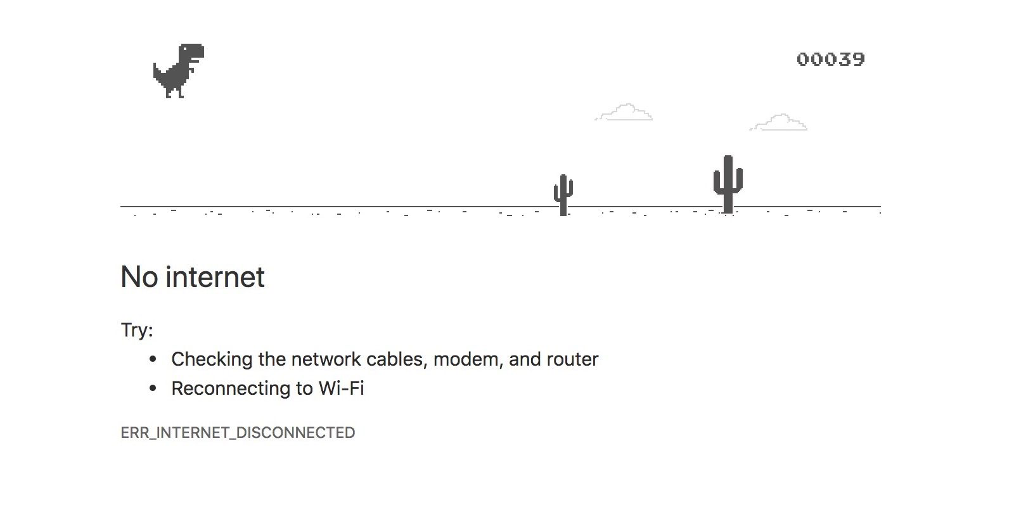


Family of open-source LLMs developed by Meta.
7B
8B
CodeLLaMA
LLaMA-3
Understand and generate code, powerful for coding and software development.
Excel in understanding and generating natural text in many tasks.
30

Slide 31
DeobfuscaThor CodeLLaMA LLaMA-3
Challenge - Revert field renaming obfuscation in Android APKs
31
Notes:
15

Slide 32
RQ1
RQ2
How effective are LLMs and how does their performance (code-specific and general) compare?
In the LLM era, does it still make sense to develop ad hoc tools?
Challenge - Revert field renaming obfuscation in Android APKs
32

Slide 33
Deobfuscate the given code by replacing all the obfuscated field names enclosed between @@ symbols with the most probable unobfuscated names. Output only a JSON object where the keys are the obfuscated field names and the values are the corresponding unobfuscated names. Do not include any additional text, explanations, or comments. The output should be strictly in JSON format. Even in case of multiple obfuscated field names, ensure that every obfuscated field name present in the input has a corresponding unobfuscated name in the output.
Instruction
Method to be deobfuscated
void fillBottle() {
this.2hehoj = True;
System.out.println(“Bottle:”, this. 2hehoj)
}
CodeLLaMA
+
LLaMA-3
Prompt Engineering
Build specific prompt to ask the LLM to deobfuscate.
33

Slide 34
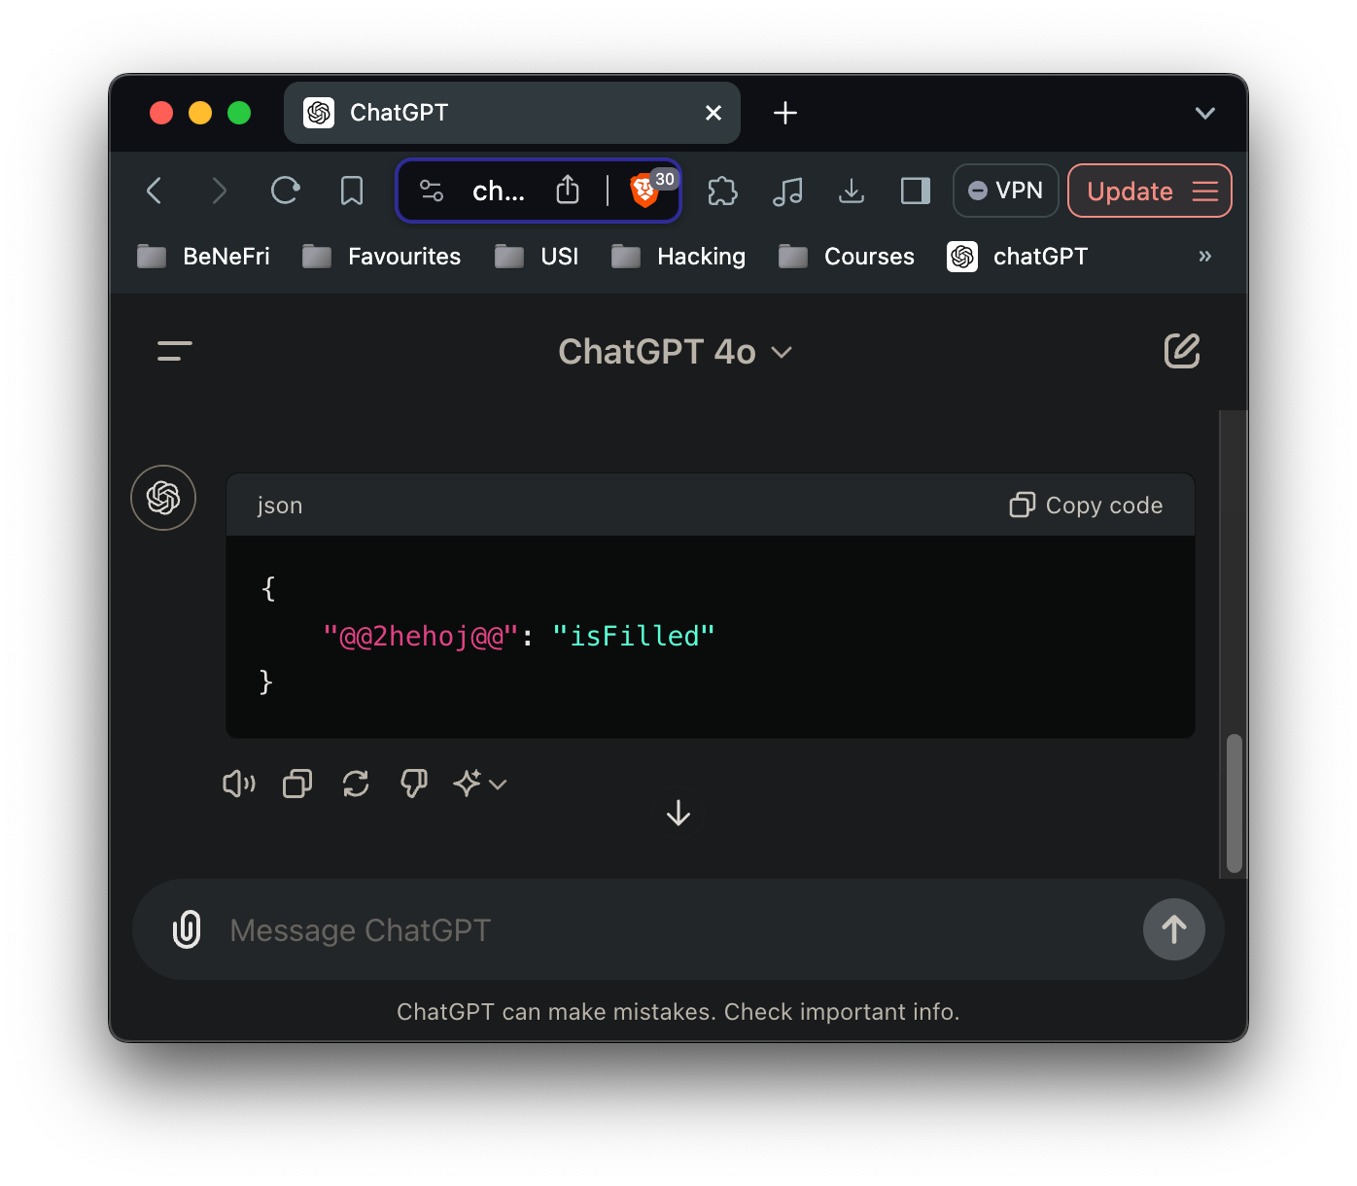
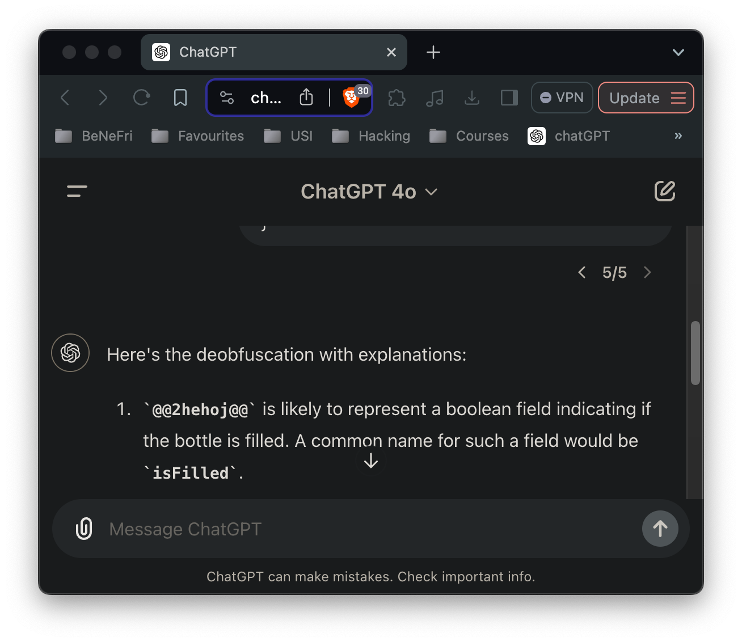
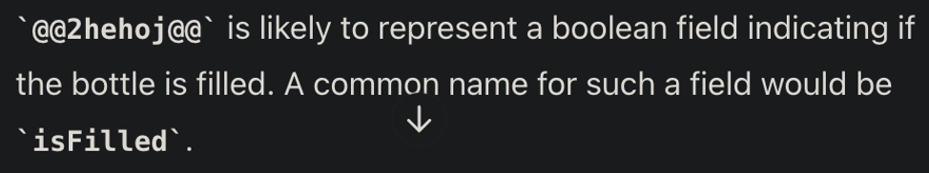

Instruction
Method to be deobfuscated
Format
Deobfuscate …
void fillBottle() {
this.2hehoj = True;
System.out.println(“Bottle:”, this. 2hehoj)
}
CodeLLaMA
correct
+
wrong
LLaMA-3
CodeLLaMA
CodeLLaMA
34

Slide 35

To which extent LLMs understand the task?
Instruction
Method to be deobfuscated
Format
Deobfuscate …
void fillBottle() {
this.2hehoj = True;
System.out.println(“Bottle:”, this. 2hehoj)
}
CodeLLaMA
correct
+
wrong
LLaMA-3
 | correct
 | 74.3%
 | 85.7%
Cumulative evaluation repeated with 2 different seeds
LLMs don’t always solve the task correctly. LLaMA-3 is better.
35

Slide 36

Is task understanding related to method’s length?
Instruction
Method to be deobfuscated
Format
Deobfuscate …
void fillBottle() {
this.2hehoj = True;
System.out.println(“Bottle:”, this. 2hehoj)
}
CodeLLaMA
correct
+
wrong
LLaMA-3
Short methods almost always correctly processed
Lot of large methods wrongly processed
LLaMA-3 significantly better understands longer methods than CodeLLaMA.
36

Slide 37

Is task understanding related to method’s number of fields?
Instruction
Method to be deobfuscated
Format
Deobfuscate …
void fillBottle() {
this.2hehoj = True;
System.out.println(“Bottle:”, this. 2hehoj)
}
CodeLLaMA
correct
+
wrong
LLaMA-3
Lot of 1-field methods correctly processed
Almost all 35-field methods wrongly processed
LLaMA-3 significantly better understands methods with more fields than CodeLLaMA.
37

Slide 38
How much space do they take?
0.1B
7B
8B
Resources
*size
Number of parameters.
0.01
0.40
0.38
1-GPU time to correctly de-obfuscate a method.
How much time do they take?
0.4GB*
3.8GB*
4.7GB*
DeofuscaThor is significantly smaller and faster.
38

Slide 39
Not considering language declensions
Exact match
44.7%
field name
original | predicted
language | language
 | lang
void selectLanguage(String l) {
this.2hehoj = l;
System.out.println(“Lang:”, this. 2hehoj)
}
18.4%
14.1%
DeofuscaThor is much more accurate than LLMs.
LLMs have room for improvement.
39

Slide 40
field name
original | predicted
language | language
 | lang
 | bottle
void selectLanguage(String l) {
this.2hehoj = l;
System.out.println(“Lang:”, this. 2hehoj)
}
Jaccard similarity | Levenshtein distance | Longest common subsequence | Rouge recall | Rouge precision | Rouge F1
 | 0.59 | 5.84 | 0.68 | 0.48 | 0.51 | 0.49
 | 0.46 | 8.19 | 0.59 | 0.30 | 0.31 | 0.30
 | 0.45 | 8.13 | 0.58 | 0.27 | 0.28 | 0.26
More exhaustive ways to calculate similarity
DeofuscaThor reaches the best scores.
CodeLLaMA slightly better than LLaMA-3.
Metrics from literature
40
Notes:
Cannot detect synonyms

Slide 41
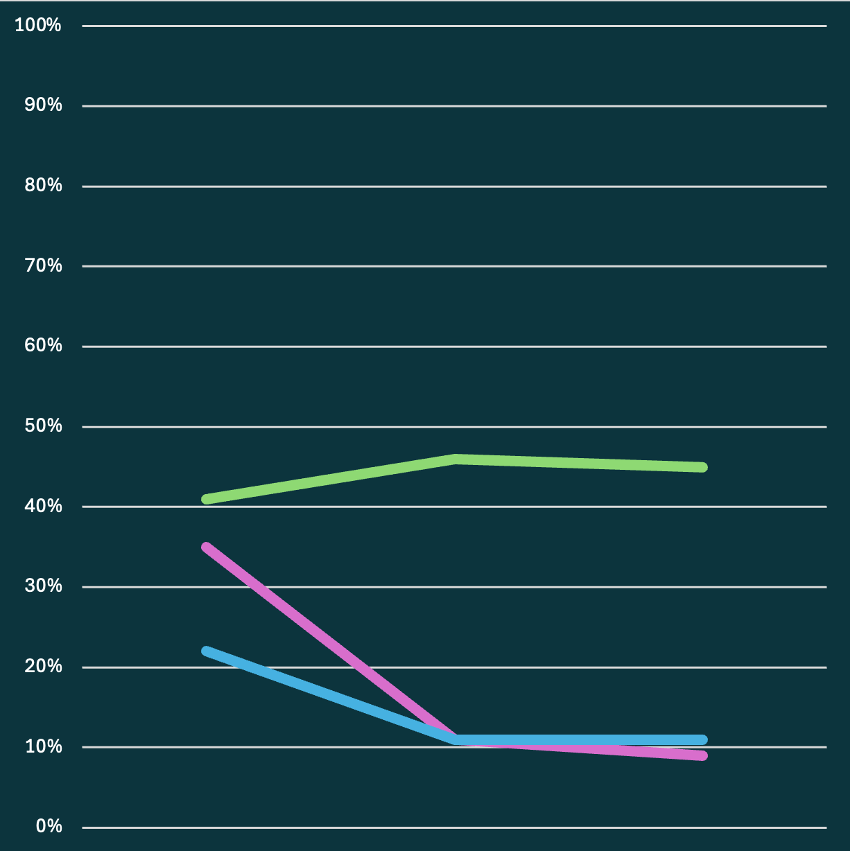
Exact match [%] varying method’s length
Is the performance influenced by method’s length?
Broader context of larger methods allows DeobfuscaThor to improve but negatively impact LLMs.
short
medium
large
More context only helps DeobfuscaThor.
41

Slide 42
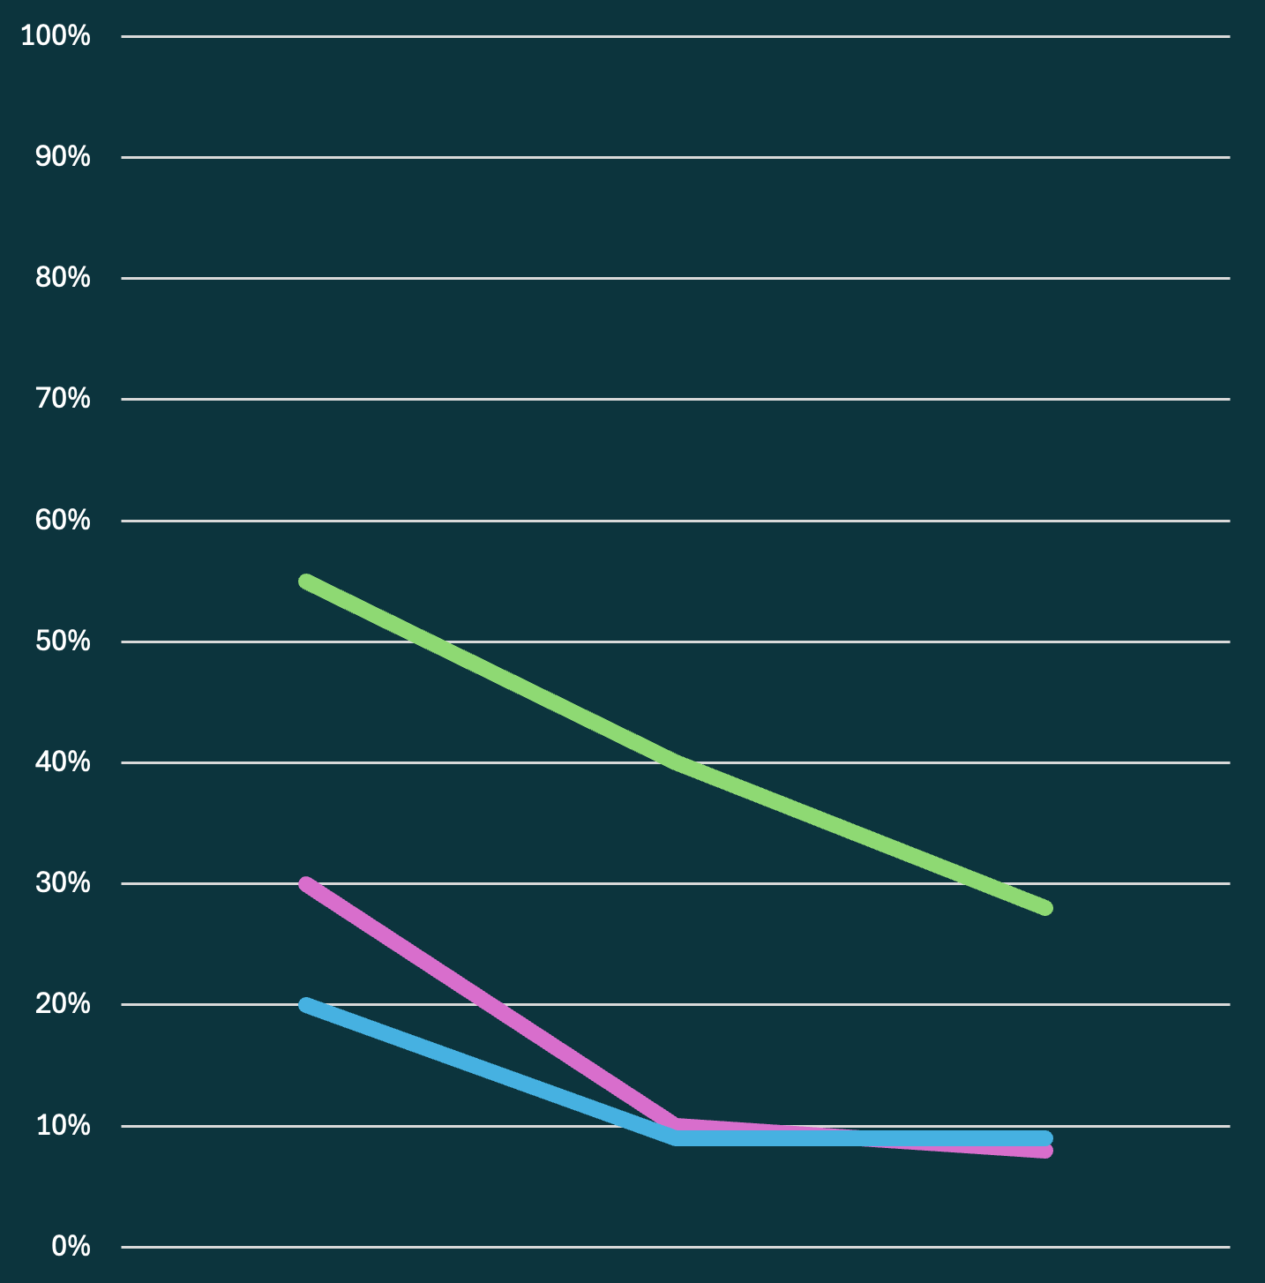
Exact match [%] varying method’s number of fields
Is the performance influenced by method’s number of fields?
All models struggle with more fields, which confuse the models introducing chaos.
1 field
5 fields
10 fields
More obfuscated fields at the same time negatively affects accuracy.
42

Slide 43
[zero-shot prompt] The following example shows how to carry out the task: Input obfuscated method = "public double computeTriangleArea() { if (this.@@f0960fb65@@ <= 0 || this.@@f601bfa9d@@ <= 0) { throw new IllegalArgumentException("Base and height must be greater than zero."); } return 0.5 * this.@@f0960fb65@@ * this.@@f601bfa9d@@; }" Expected output = {"f0960fb65": "triangleBase", "f601bfa9d": "triangleHeight"}
Instruction + Example
Method to be deobfuscated
void fillBottle() {
this.2hehoj = True;
System.out.println(“Bottle:”, this. 2hehoj)
}
CodeLLaMA
+
LLaMA-3
Zero- vs. One-shot
Give an example about how to solve the task.
43

Slide 44
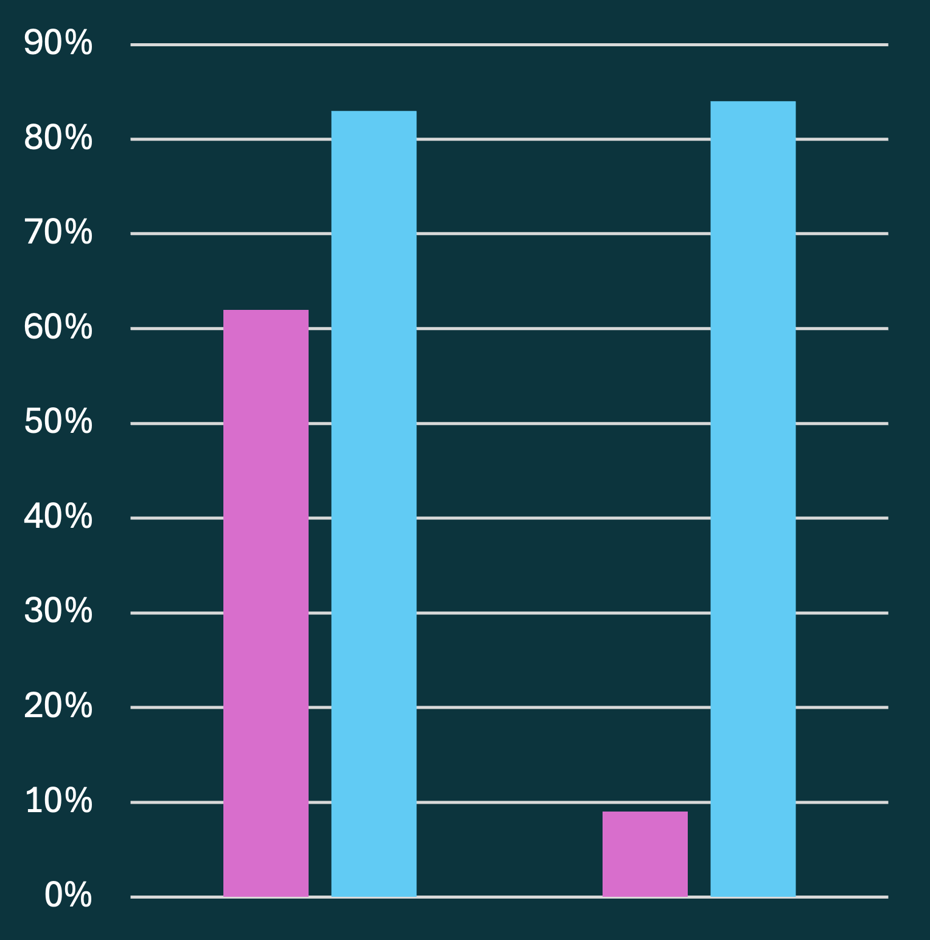
Task understanding
Zero vs. One-shot
CodeLLaMA improves performance but significantly reduces correctly formatted answers.
LLaMA-3 increases correctly formatted answers but decreases exact match performance
Zero-shot
One-shot
General-purpose LLMs slightly improve task understanding, but Code-specific LLMs get confused, resulting in a big loss in task understanding.
44

Slide 45
RQ1
How effective are LLMs and how does their performance (code-specific and general) compare?
Room for improvement, especially handling complex methods
General-purpose better at task understanding
Code-specific slightly better predictions
45
Notes:
One-shot is part of that

Slide 46
RQ2
In the LLM era, does it still make sense to develop ad hoc tools?
Definitely!
Ad hoc tools significantly higher accuracy
More suitable for resource-constrained environments
46

Slide 47



Future works
Test deobfuscation capabilities of other LLMs (Mistral, Qwen-2, StarCoder-2 and their variants).
Extend DeobfuscaThor to handle method and class renaming obfuscations.
Investigate a potential hybrid approach.
47
Notes:
Repeat LLM evaluation using a different LLM for greater validity.

Slide 48

Special thanks
Valerio Schiavoni | David Bromberg | Leonardo Querzoni
MER, University of Neuchâtel | Professor, University of Rennes | Professor, Sapienza University of Rome
Giuseppe Antonio di Luna | Daniele Cono D’Elia | Simon Queyrut
Associate Professor, Sapienza University of Rome | Assistant Professor, Sapienza University of Rome | PhD Student, University of Neuchâtel
48

Slide 49
Thanks!
Do you have any questions? Or do you want the apero?
jacopo.caratti@students.unibe.ch
carattj.github.io
Please keep this slide for attribution

Slide 50
Metrics
Jaccard similarity | Levenshtein distance | LCS
Longest character subsequence appearing in order in 2 strings | Min number of edits (insertions, deletions, replacements) to transform one string into another | Longest character subsequence appearing in order in 2 strings
Rouge recall | Rouge precision | Rouge F1
N-grams in the ground truth that are also in the prediction | N-grams in the prediction that are also in the ground truth | Harmonic mean of precision and recall
48

